Slide 1
Angular
Service, Dependency Injection, and Component Lifecycle Hooks
Lecture 4
By James(Jin) Wang
09/01/2019

Slide 2
Outline
Services
Dependency Injection
Component Lifecycle Hooks

Slide 3
Services
  A Service provides anything our application needs.
  It often shares data or functions between other Angular features

Slide 4
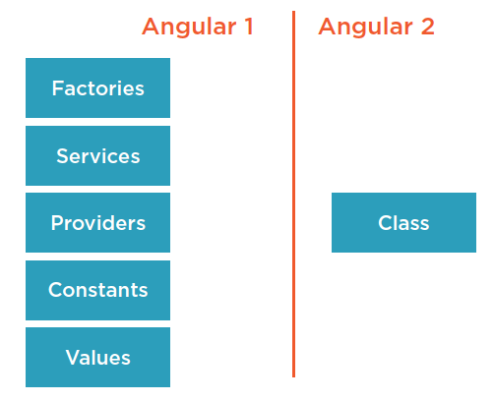
Services

Slide 5
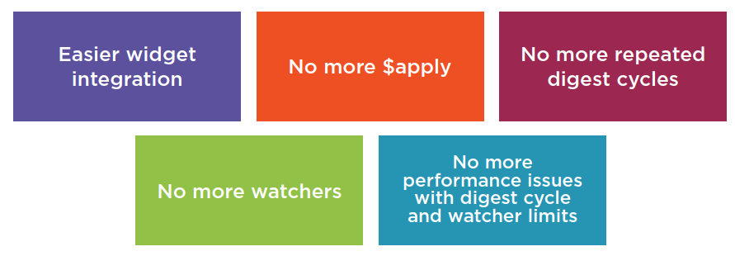
Data Binding

Slide 6
Interpolation
  Using the {{ }} to render the bound value to the Component’s Template

Slide 7
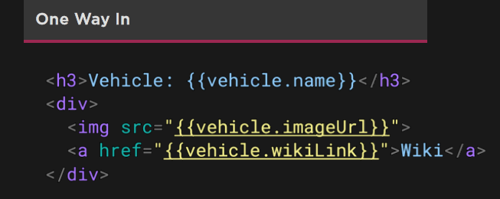
Interpolation
  Interpolation:
  Evaluate an expression between double curly braces
  {{ expression }}
  Demo: Data Binding and Directives

Slide 8
Property Binding
  Using the [ ] to send values from the Component to the Template

Slide 9
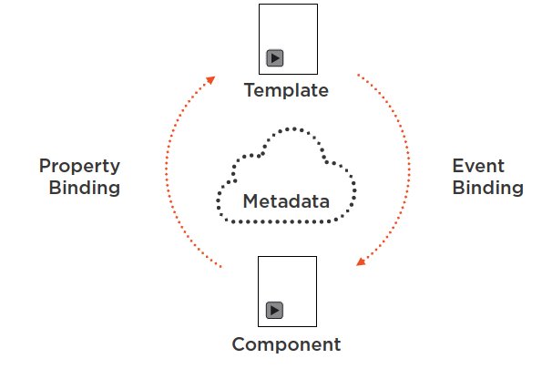
Property Binding

Slide 10
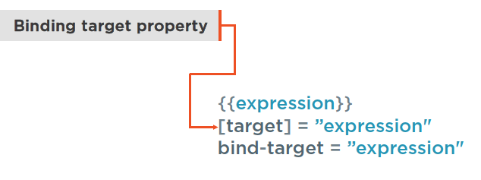
Property Binding
  One Way:
  Data source to view target

Slide 11
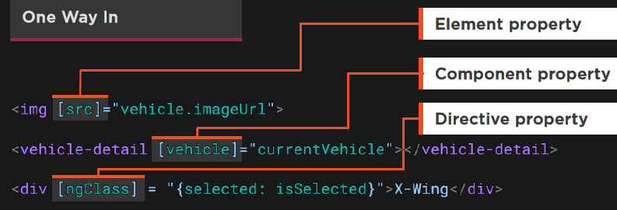
Property Binding
  Property Binding:
  [property] = “expression”
  Bind to element, Component or a directive property

Slide 12
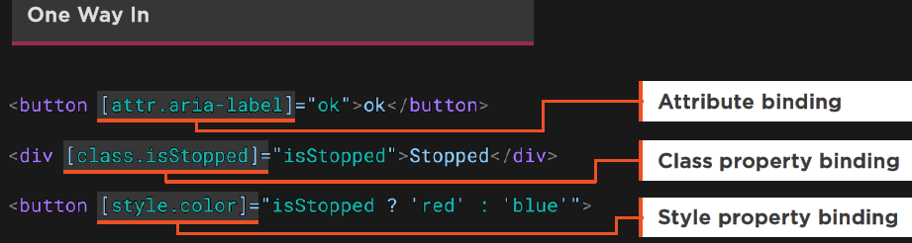
Property Binding
  Property Binding:
  For attributes use attr
  Use dots for nested properties
  Demo: Data Binding and Directives

Slide 13
Event Binding
  Using the ( ) to send events from the Template to the Component

Slide 14
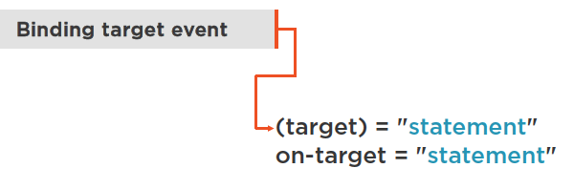
Event Binding
  One Way:
  View target to data source

Slide 15
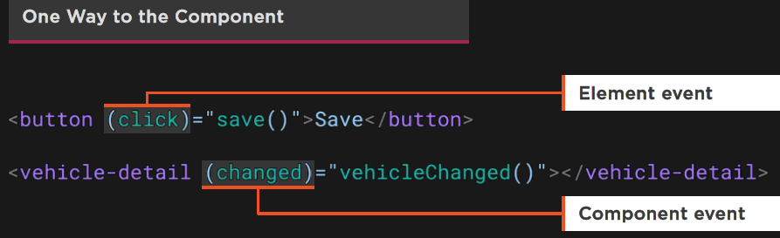
Event Binding
  Event Binding:
  Execute an expression when an event occurs
  (event-target) = “statement”

Slide 16
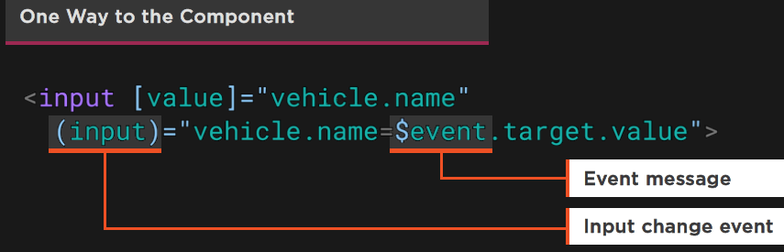
Event Binding
  $event:
  Contains a message about the event

Slide 17
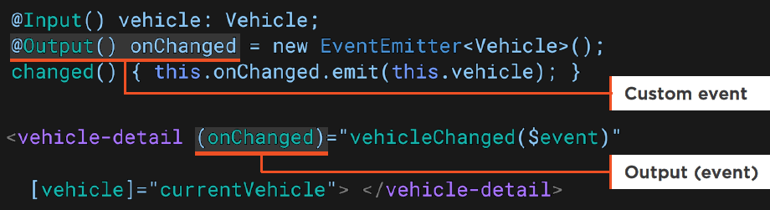
Event Binding
  Custom Events:
  EventEmitter defines a new event
  Fire its emit method to raise event with data
  Bind to the event on the Component’s Template
  Demo: Data Binding and Directives

Slide 18
Two Way Binding
  [( )] sends a value from Component to Template, and sends value changes in the Template to the Component

Slide 19

Two Way Binding

Slide 20
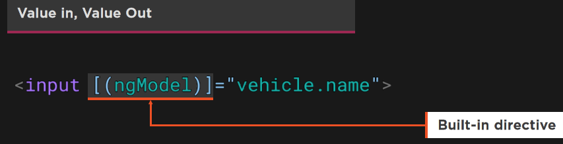
Two Way Binding
  Two Way Binding:
  [( )] = Football in a box

Slide 21
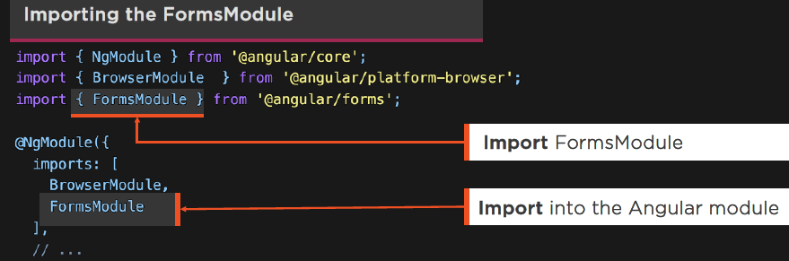
Two Way Binding
  Using ngModel:
  Import FormsModule
  Add it to the Angular module’s import list

Slide 22
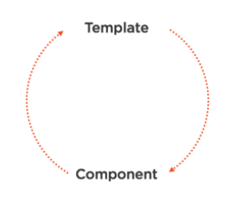
Data Binding

Slide 23
Directives
  When Angular renders templates, it transforms the DOM according to instructions from Directives.

Slide 24
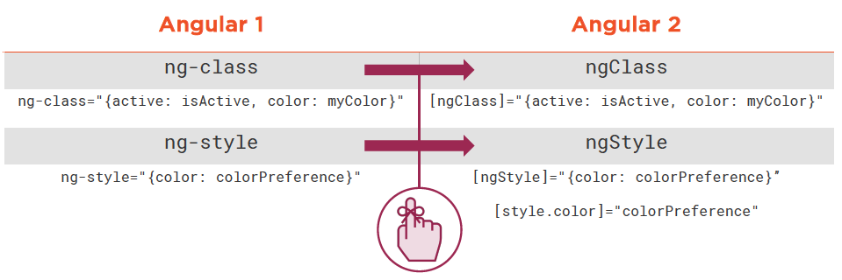
Directives

Slide 25
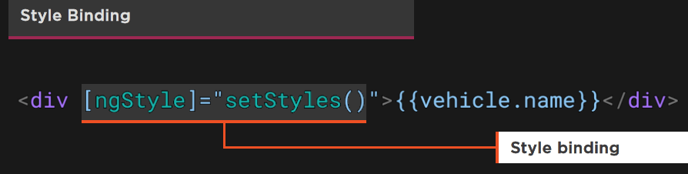
Directives
  ngStyle:
  Alternative to [style.style-name]
  Setting multiple styles

Slide 26
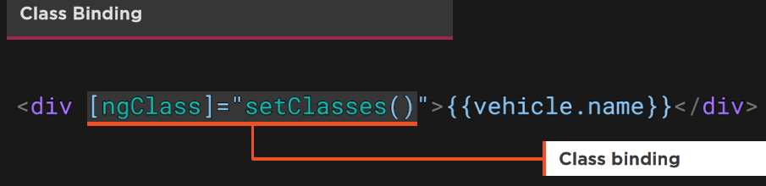
Directives
  ngClass:
  Alternative to [class.class-name]
  Setting multiple classes

Slide 27
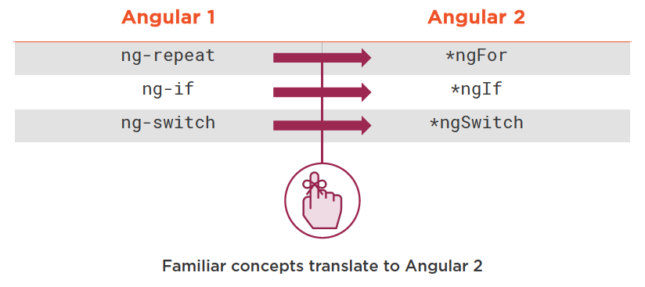
Directives

Slide 28
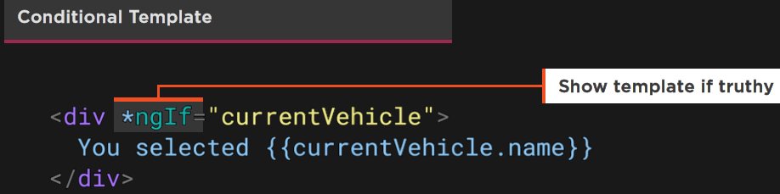
Directives
  *ngIf:
  Conditionally removes elements from the DOM
  Structural directive
  Use [style.visibility] = “isVisible()” to hide

Slide 29
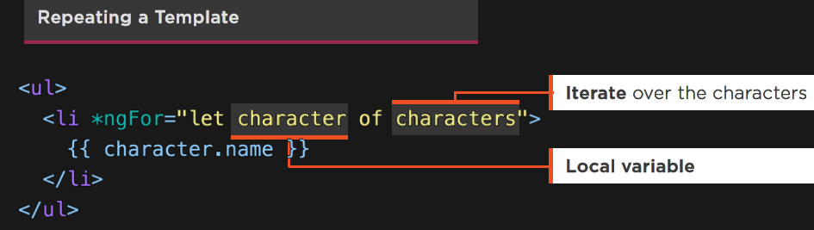
Directives
  *ngFor:
  Structural directive
  Show an element n number of times
  Let declares a local variable

Slide 30
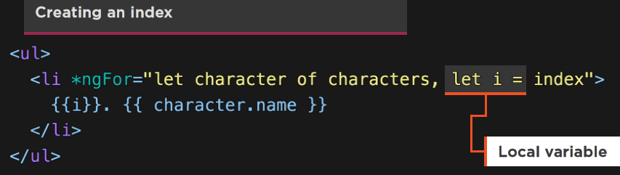
Directives
  Local Variable:
  Let declares a local variable

Slide 31
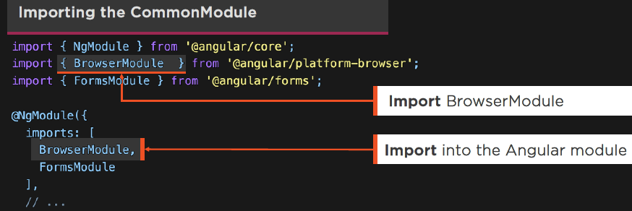
Directives
  Using Built-In Directives:
  BrowserModule imports CommonModule
  Import and add it to the Angular module’s import list
  Demo: Data Binding and Directives

Slide 32
Pipes
  Pipes allow us to transform data for display in a Template

Slide 33
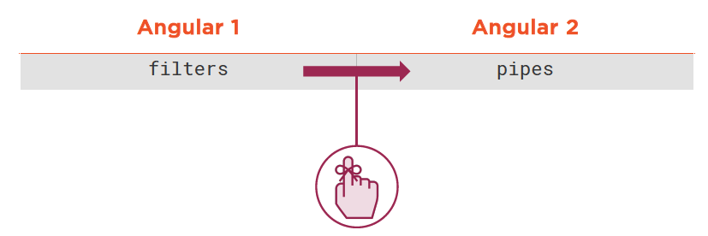
Pipes
  Angular Formatters:

Slide 34
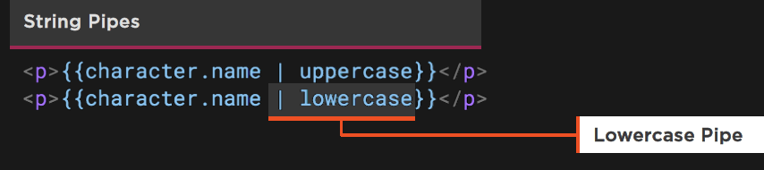
Pipes
  Built-In Pipes:
  Format a value in a Template

Slide 35
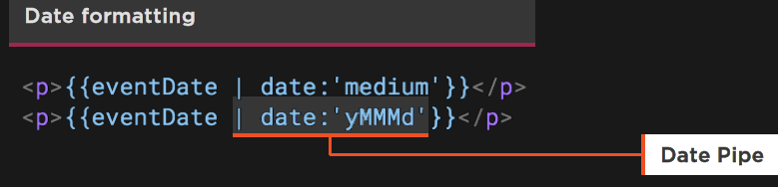
Pipes
  Date Pipes:
  Date accepts format
  Expression | date[:format]

Slide 36
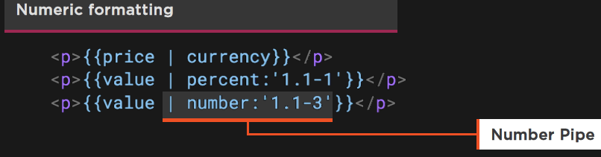
Pipes
  Numeric Pipes:
  Number and Percent accept digitInfo
  Expression | number[:digitInfo]
  {minIntegerDigits}.{minFractionDigits}-{maxFractionDigits}

Slide 37
Async Pipe
  Subscribes to a Promise or an Observable, returning the latest value emitted

Slide 38
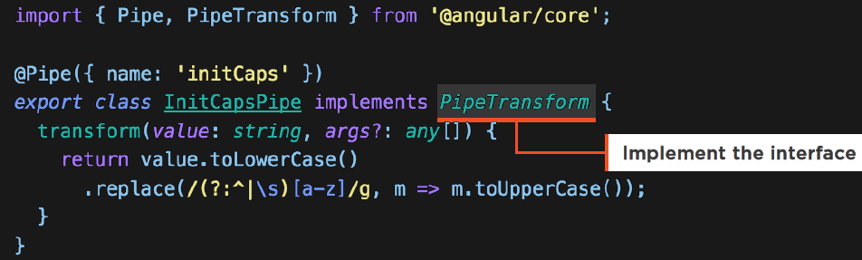
Async Pipe
  Custom Pipes:
  @Pipe decorator
  Value to transform
  Optional args

Slide 39
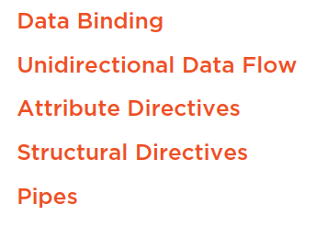
Summary

